Slide 1
Data Analytics Agent (smol)
“For when people bother you for adhoc requests”

Slide 2
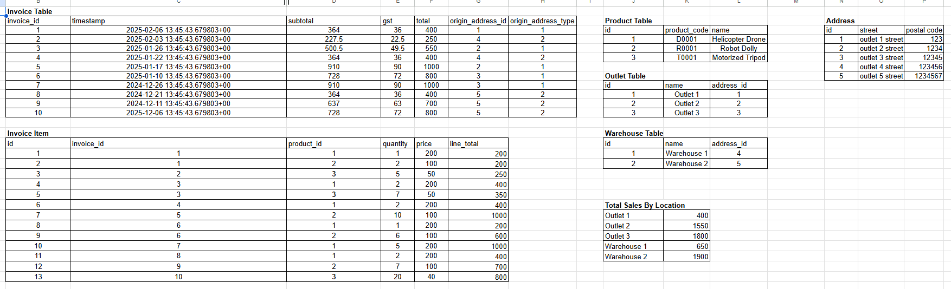
You have many tables, that links to each other

Slide 3
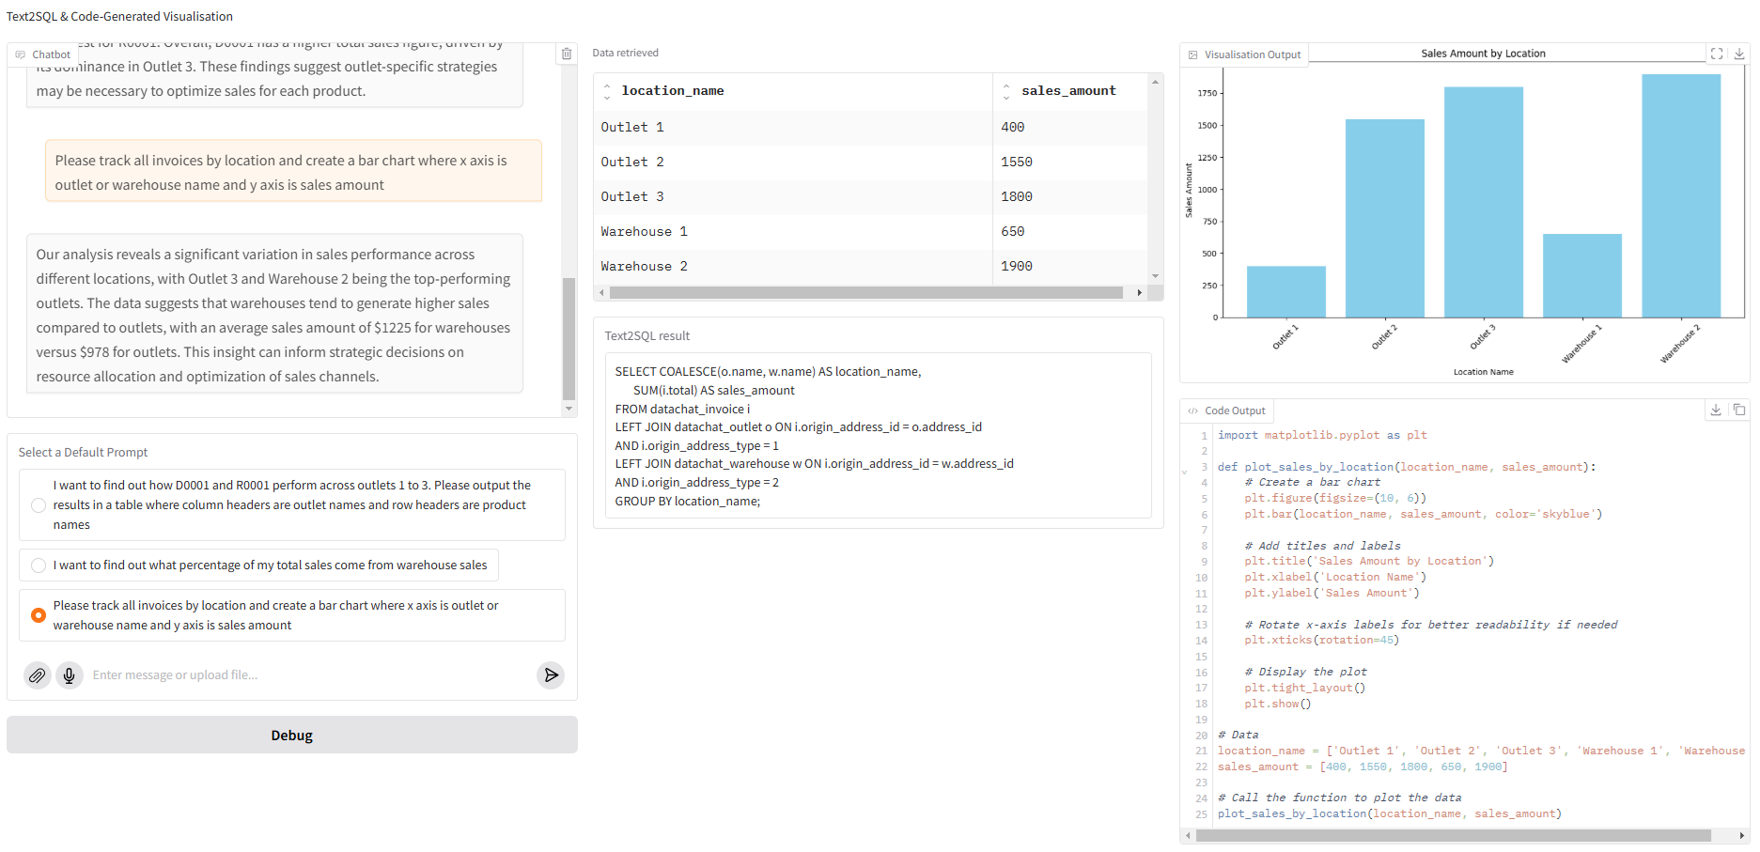
And when stakeholders make an adhoc request,

Slide 4
automate away !

